Slide 1
Chapter 11 The Money Markets

Slide 2
Financial System Overview (2)
Financial Markets
Financial Institutions
Bond Market (3,5,12)
Stock Market (13,6)
Money Market (11)
Mortgage Market (14)
Why Exists (7)
Banking Industry (19)
Mutual Fund Industry(20)
Hedging with Financial Derivatives (24)

Slide 3
Now that’s a lot!
In its 2015 annual report, Apple listed $20.4 billion in short-term securities on its balance sheet, plus $21 billion in actual cash equivalents. Apple does not keep this in its local bank. But where?
This is, of course, this topic of chapter 11—Money Markets.

Slide 4
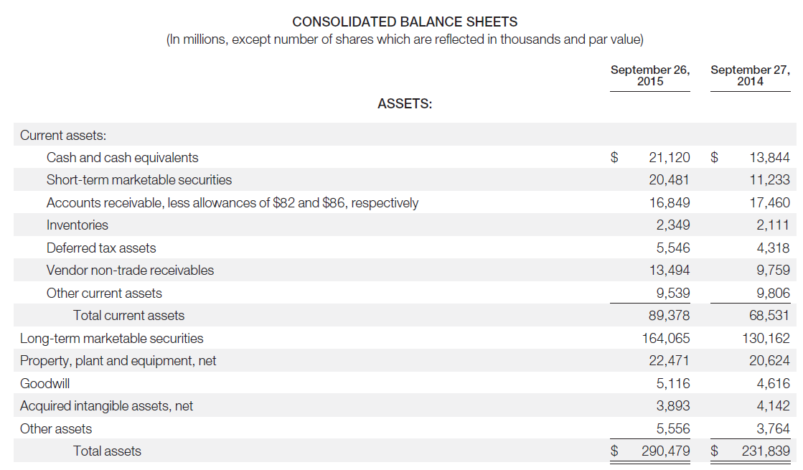
Source: Apple annual report 2015

Slide 5
Cash Equivalents and Marketable Securities
All highly liquid investments with maturities of three months or less at the date of purchase are classified as cash equivalents. ….
Marketable debt securities with maturities of 12 months or less are classified as short-term and marketable debt securities with maturities greater than 12 months are classified as long-term…
Source: Apple annual report 2015

Slide 6
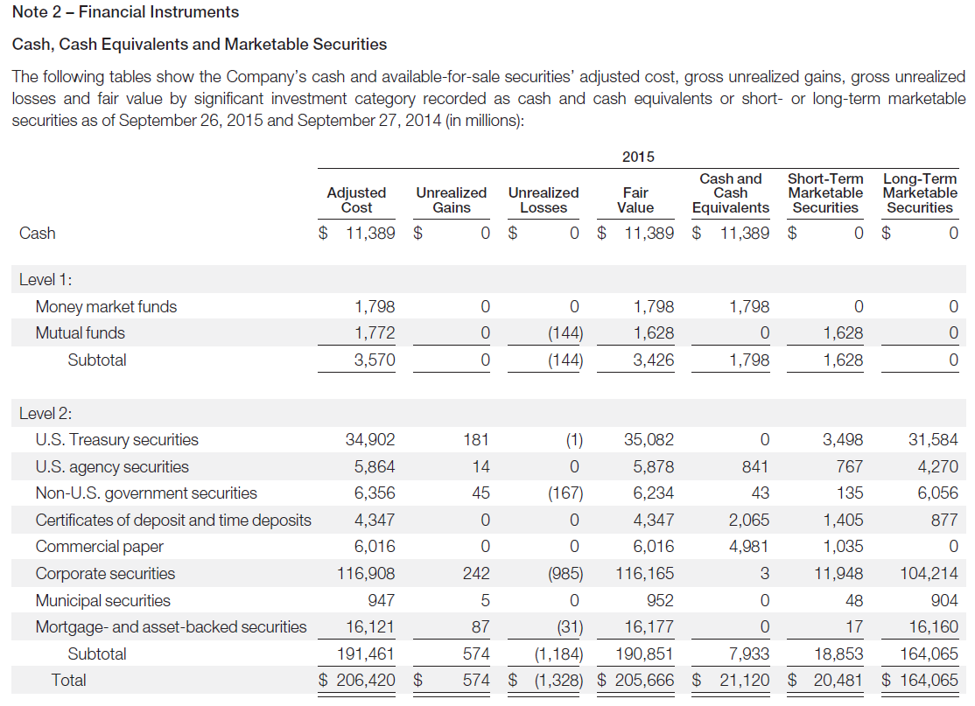
Source: Apple annual report 2015

Slide 7
Chapter Outline
The Money Markets Defined
The Purpose of Money Markets
Who Participates in Money Markets?
Money Market Instruments
Comparing Money Market Securities

Slide 8
The Money Markets Defined
The term “money market” is a misnomer. Money (currency) is not actually traded in the money markets.
The securities in the money market are short term with high liquidity; therefore, they are close to being money.
Money Markets Defined
Usually sold in large denominations ($1,000,000 or more)
Low default risk
Mature in one year or less from their issue date, although most mature in less than 120 days

Slide 9
The Money Markets Defined: Why Do We Need Money Markets?
Banking industry should handle the needs for short-term.
Banks have an information advantage.
Banks can offer loans more cheaply than diversified markets
Money market short-term securities are neither as liquid nor as safe as deposits placed in banks.
Banks are subject to more regulations and governmental costs than are the money market.
If asymmetric information is not severe, money markets have a distinct cost advantage over banks in providing short-term funds.

Slide 10
The Money Markets Defined: Cost Advantages
Reserve requirements create additional expense for banks that money markets do not have
Regulations on the level of interest banks could offer depositors lead to a significant growth in money markets, especially in the 1970s and 1980s.
When interest rates rose, depositors moved their money from banks to money markets.
The cost structure of banks limits their competitiveness to situations where their informational advantages outweighs their regulatory costs.

Slide 11
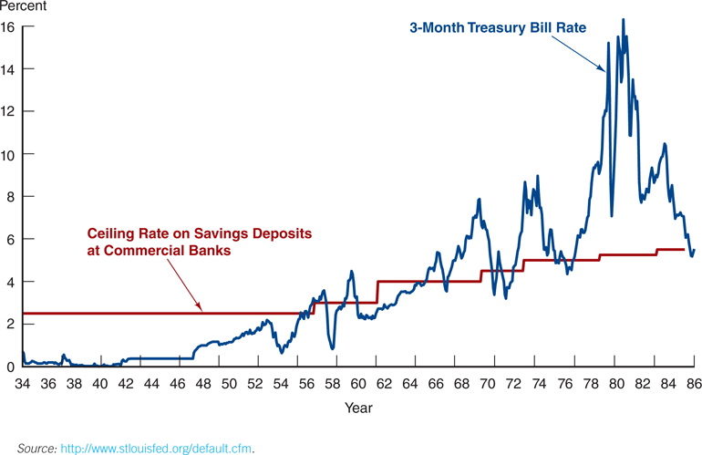
Figure 11.1 Three-Month Treasury Bill Rate and Ceiling Rate on Savings Deposits at Commercial Banks, 1933 to 1986

Slide 12


The Purpose of Money Markets
Investors in Money Market:
Provides a place for warehousing
surplus funds for short periods
of time
Borrowers from money market:
provide low-cost source of
temporary funds

Slide 13
The Purpose of Money Markets
Most investors use the money market as an interim investment that provides a higher return than holding cash or money in banks.
Market conditions are not right to invest in stocks
Expect the interest rate to rise and not want to buy bonds
Can act quickly to the investment opportunities
Most investment funds and financial intermediaries need to meet deposit outflows
Corporations and U.S. government use these markets because the timing of cash inflows and outflows are not well synchronized.
Money markets provide a way to solve these cash-timing problems.

Slide 14
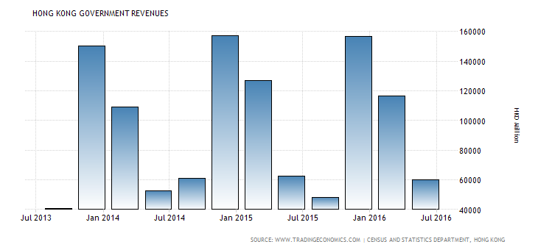
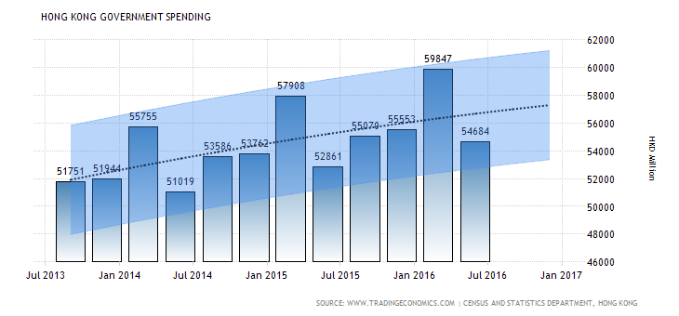
http://www.tradingeconomics.com/hong-kong/government-revenues

Slide 15
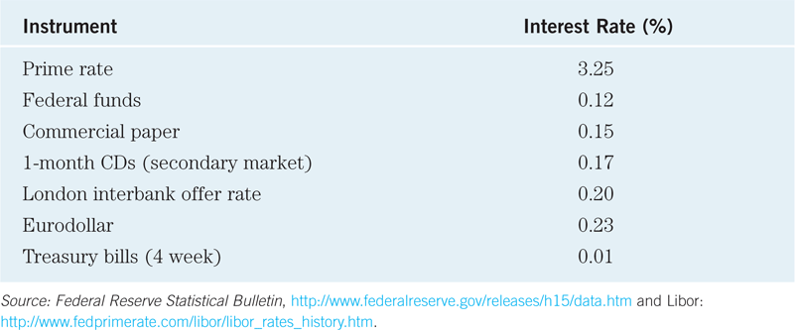
The Purpose of Money Markets: Sample rates from the Federal Reserve
Table 11.1 Sample Money Market Rates, May 15, 2013
The prime rate is the interest rate that commercial banks charge
their most credit-worthy customers. Generally, a bank's best
customers consist of large corporations.

Slide 16
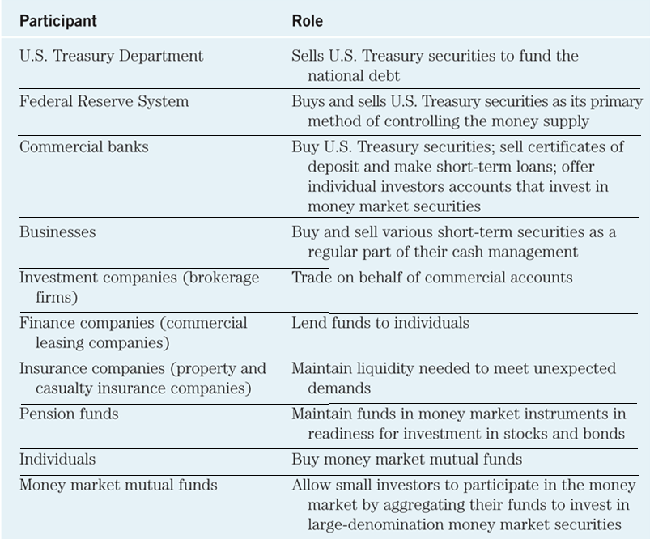
Table 11.2 Money Market Participants

Slide 17
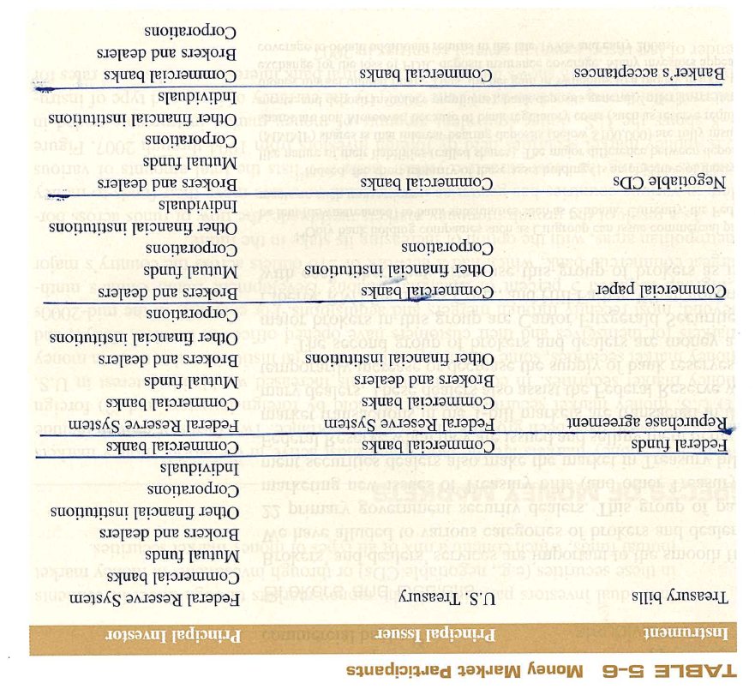

Slide 18
Chapter Outline
The Money Markets Defined
The Purpose of Money Markets
Who Participates in Money Markets?
Money Market Instruments
Comparing Money Market Securities

Slide 19
Money Market Instruments
Treasury Bills
Federal Funds
Repurchase Agreements
Negotiable Certificates of Deposit
Commercial Paper
Banker’s Acceptance
Eurodollars

Slide 20
Money Market Instruments: Treasury Bills
T-bills have 28-day maturities through 12- month maturities.
Discounting:
Most money market securities do not pay interest
When an investor pays less for the security than it will be worth when it matures, and the increase in price provides a return.
This is common to short-term securities because they often mature before the issuer can mail out interest checks.

Slide 21
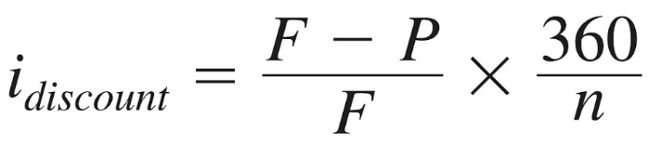


Money Market Instruments: Treasury Bills Discounting Example
You pay $999.81333 for a 28-day T-bill. It is worth $1,000 at maturity. What is its discount rate?
= $\frac{\$1000 − \$999.81333}{\$1000}×\frac{360}{28}$
= $0.242\%$

Slide 22
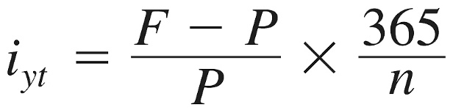


Money Market Instruments: Treasury Bills Discounting Example
You pay $999.81333 for a 28-day T-bill. It is worth $1,000 at maturity. What is its annualized yield?
= $\frac{\$1000 − \$999.81333}{\$999.81333}×\frac{365}{28}$
= $0.243\%$

Slide 23
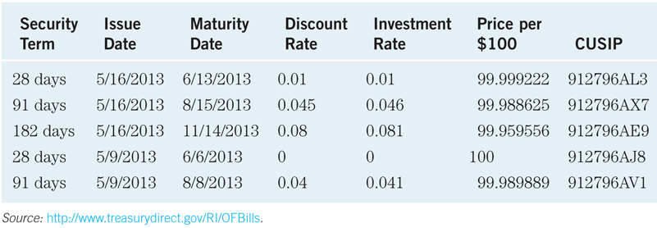
Money Market Instruments: Treasury Bill Auction Results
Table 11.3 Recent Bill Auction Results

Slide 24
Money Market Instruments: Treasury Bill Auctions
T-bills are auctioned to the dealers every Thursday.
The Treasury may accept both competitive and noncompetitive bids, and the price everyone pays is the highest yield paid to any accepted bid.
competitive bids: state both the amount and price
Generally used by large investors and government securities dealers
Specify the desired quantity of T-bill and the bid price.
Individual competitive bidders limited to 35% total issue size (limits the ability of one bidder to “squeeze” the market.
One bidder can submit more than one bids
The highest bidder receives the first allocation of T-bills, and subsequent bids are filled in decreasing order until all T-bills auctioned that week are distributed.
The price paid by all bidders is, the lowest price of accepted competitive bidders
noncompetitive bids: state only the amount
Limited to $1million or less and allow small investors to participate in the T-bill auction market
Indicate quantity desired and agree to pay the lowest price of the winning competitive bids
Get preferential allocation: all noncompetitive bidders always receive 100% allocation.
Competitive bidders may or may not end up buying securities
Non-competitive bidders are guaranteed

Slide 25
Money Market Instruments: Treasury Bill Auctions Example
The Treasury auctioned $2.5 billion par value 91-day T-bills, the following bids were received:
Bidder Bid Amount Bid Price
1 $500 million $0.9940
2 $750 million $0.9901
3 $1.5 billion $0.9925
4 $1 billion $0.9936
5 $600 million $0.9939
The Treasury also received $750 million in noncompetitive bids. Who will receive T-bills, what quantity, and at what price?

Slide 26
Money Market Instruments: Treasury Bill Auctions Example
The Treasury accepts the following bids:
Bidder Bid Amount Bid Price
1 $500 million $0.9940
5 $600 million $0.9939
4 $650 million $0.9936
Both the competitive and noncompetitive bidders pay the highest yield—based on the price of 0.9936:

Slide 27
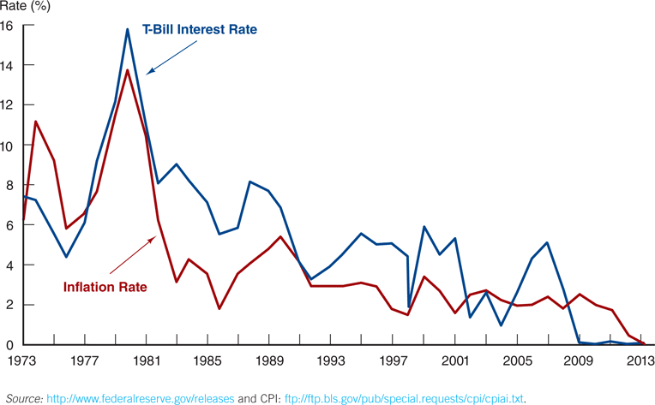
Figure 11.2 Treasury Bill Interest Rate and the Inflation Rate, January 1973–January 2013
May not keep up with inflation
T-bill is not any investment to be
used for anything but temporary
storage of excess funds

Slide 28
Money Market Instruments: Fed Funds
Short-term funds transferred (loaned or borrowed) between financial institutions, usually for a period of one day.
Used by banks to meet short-term needs to meet reserve requirements.
The term is misleading, nothing to do with the federal government!
The fed funds market began in 1920s when banks with excess reserves loaned them to banks that need them.
Federal Funds Rate
The interest rate for borrowing fed fund
A focus or target rate in the conduct of monetary policy
Usually slightly higher than T-bill rate

Slide 29
Trading in the Federal Funds Market
Commercial banks conduct the majority of transactions in the Fed funds market.
Banks with excess reserves lend fed funds, while banks with deficient reserves borrow fed funds.
Negotiations between two depository institutions may take directly over a telecommunications network or may occur through a federal funds broker.
Fed district bank debits the sale (lending) institution’s reserve account, and credits the purchase (borrowing) institution’s reserve account.
Usually $5 million or more

Slide 30
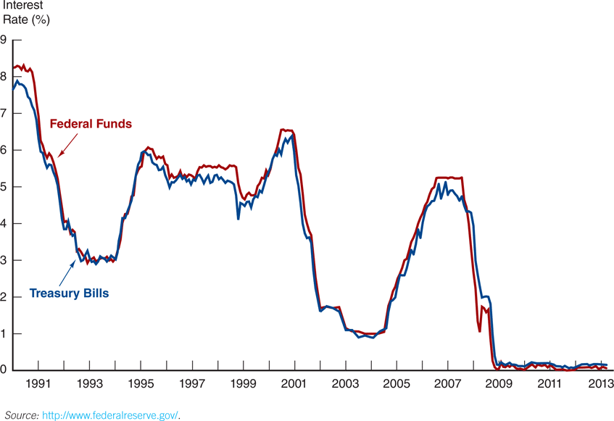
Figure 11.3 Federal Funds and Treasury Bill Interest Rates, January 1990–January 2013
Notice that the two rates track fairly closely.

Slide 31
Money Market Instruments: Repurchase Agreements
These work similar to the market for fed funds, but nonbanks can participate.
A firm sells Treasury securities, but agrees to buy them back at a certain date (usually 3–14 days later) for a certain price.
This set-up makes a repo agreements essentially a short-term collateralized loan.
Securities dealers use the repo to manage their liquidity and to take advantage of anticipated changes in interest rates.

Slide 32
Money Market Instruments: Repurchase Agreements
This is one market the Fed may use to conduct its monetary policy, whereby the Fed purchases/sells Treasury securities in the repo market.
Repos are collateralized with Treasury securities, the are low-risk investments and have low interest rates.
Dealers and brokers used or direct placement
Secondary market is good
Most common maturities are from 1 day to 15 days

Slide 33
Money Market Instruments: Negotiable Certificates of Deposit
A bank-issued security that documents a deposit and specifies the interest rate and the maturity date
Denominations range from $100,000 to $10 million (normally > 1 million).
Typically maturity is from 1 to 4 months.
The rates paid on NCD are negotiated between the bank and the customer.
NCD rates tend to be slightly above the T-bill rate because of the slightly greater chance of default.
The primary (and secondary) market is limited to the large investors.

Slide 34
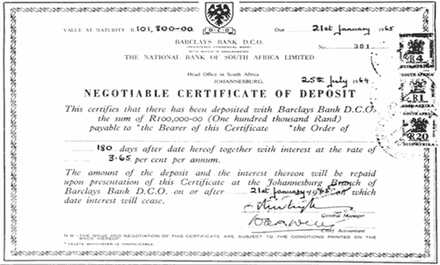
Money Market Instruments: Negotiable Certificates of Deposit
A negotiable CD is a bearer instrument.
A CD is a term security.
Term security: have a specified maturity date
Demand deposit: can be withdrawn at any time

Slide 35
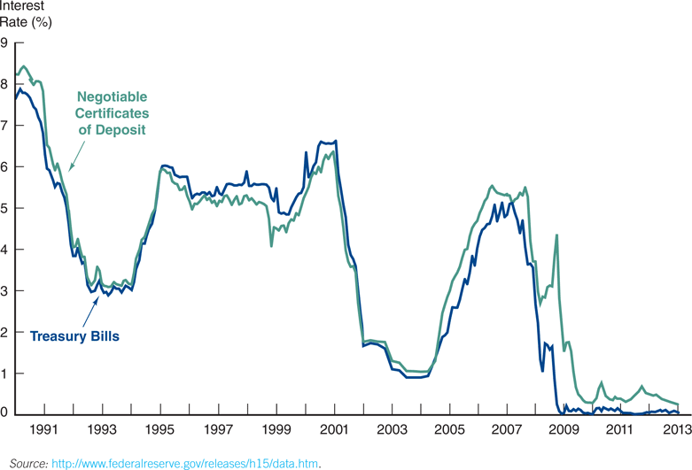
Figure 11.4 Interest Rates on Negotiable Certificates of Deposit and on Treasury Bills, January 1990–January 2013

Slide 36
Money Market Instruments: Commercial Paper
Unsecured promissory notes, issued by corporations, that mature in no more than 270 days.
Why 270 days? To avoid the need to register with SEC.
Most matures in 20-45 days.
Issued on a discounted basis.
Only the largest and most creditworthy corporations issue commercial paper.
The interest rate reflects the firm’s level of risk.
An important alternative to bank loans primarily because of lower cost.

Slide 37
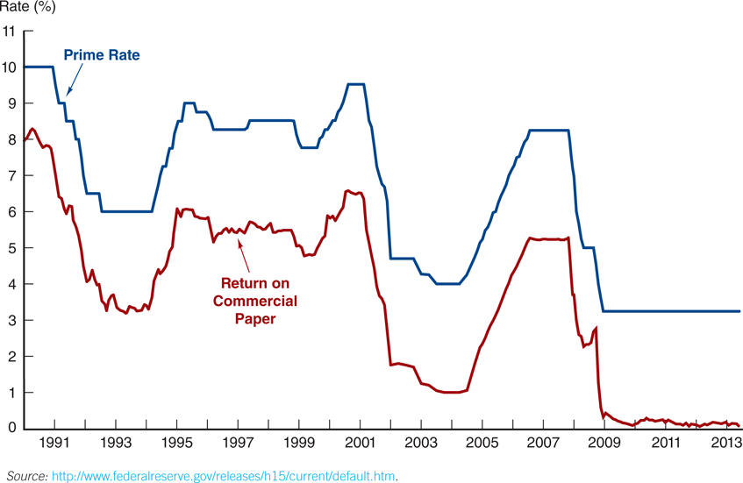
Figure 11.5 Return on Commercial Paper and the Prime Rate, 1990–2013

Slide 38
Money Market Instruments: Commercial Paper
Non-banks corporations (e.g. General Motors Acceptance Corporation) borrows money by issuing commercial paper and uses the money to make loans to consumers.
Most firms use one of about 30 commercial paper dealers who match up buyers and sellers.
Commission fee: 0.125%
Direct placements
Most issuers of commercial paper back up their paper with a line of credit at a bank.
The bank will lend the firm funds in the event the issuer cannot pay off or roll over the maturing paper.

Slide 39

Money Market Instruments: Commercial Paper
Commercial banks were the original purchasers of commercial paper, expanded to
Large insurance companies
nonfinancial businesses
bank trust departments
gov’t pension funds
Reason:
Relative low default risk
Short maturity
Somewhat higher yields

Slide 40
Money Market Instruments: Commercial Paper
The use of commercial paper increased significantly in the early 1980s because of the rising cost of bank loans.
Commercial paper volume:
fell significantly during the recent economic recession
annual market is still large, at well over $0.85 trillion outstanding

Slide 41
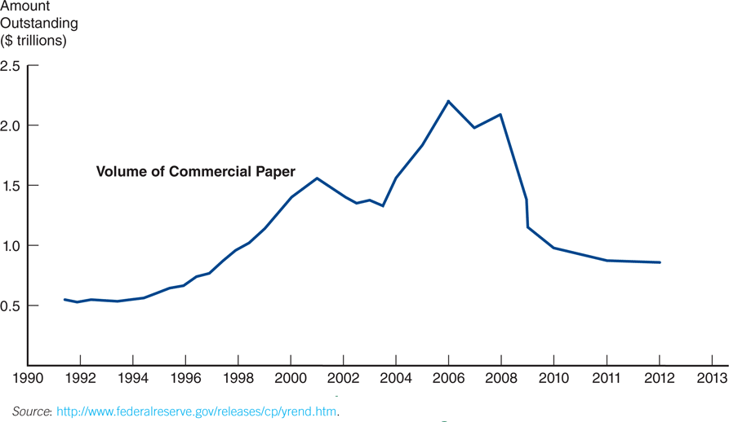
Figure 11.6 Volume of Commercial Paper Outstanding

Slide 42
Money Market Instruments: Commercial Paper
A special type of commercial paper, known as asset-backed commercial paper (ABCP)
played a key role in the financial crisis in 2008 backed by securitized mortgages
Quality of the pledged assets often difficult to understand
accounted for about $1 trillion
When the poor quality of the underlying assets was exposed, a run on ABCP began. Because ABCP was held by many money market mutual funds (MMMFs), these funds also experienced a run. The government eventually had to step in to prevent the collapse of the MMMF market.

Slide 43
Money Market Instruments: Banker’s Acceptances
Is an order to pay a specified amount to the bearer on a given date if specified conditions have been met, usually delivery of promised goods, guaranteed by a bank.
These are often used when buyers / sellers of expensive goods live in different countries. Foreign exporters prefer that banks act as guarantors for payment before sending goods to importer
As seen, banker’s acceptances avoid the need to establish the credit-worthiness of a customer living abroad.
There is also an active secondary market for banker’s acceptances until they mature. The terms of note indicate that the bearer, whoever that is, will be paid upon maturity.

Slide 44
Money Market Instruments: Eurodollars
Eurodollars represent Dollar denominated deposits held in foreign banks.
The market is essential since many foreign contracts call for payment in U.S. dollars due to the stability of the dollar, relative to other currencies.

Slide 45
Money Market Instruments: Eurodollars
The Eurodollar market has continued to grow rapidly because depositors receive a higher rate of return on a dollar deposit in the Eurodollar market than in the domestic market.
Multinational banks are not subject to the same regulations restricting U.S. banks and because they are willing to accept narrower spreads between the interest paid on deposits and the interest earned on loans.

Slide 46
Money Market Instruments: Eurodollars Rates
Some large London banks act as brokers in the interbank Eurodollar market.
Eurodollars are an alternative to fed funds. Banks from around the world buy and sell overnight funds in this market.
London interbank bid rate (LIBID)
The rate paid by banks buying funds
London interbank offer rate (LIBOR)
The rate offered for sale of the funds
Time deposits with fixed maturities
Largest short term security in the world

Slide 47
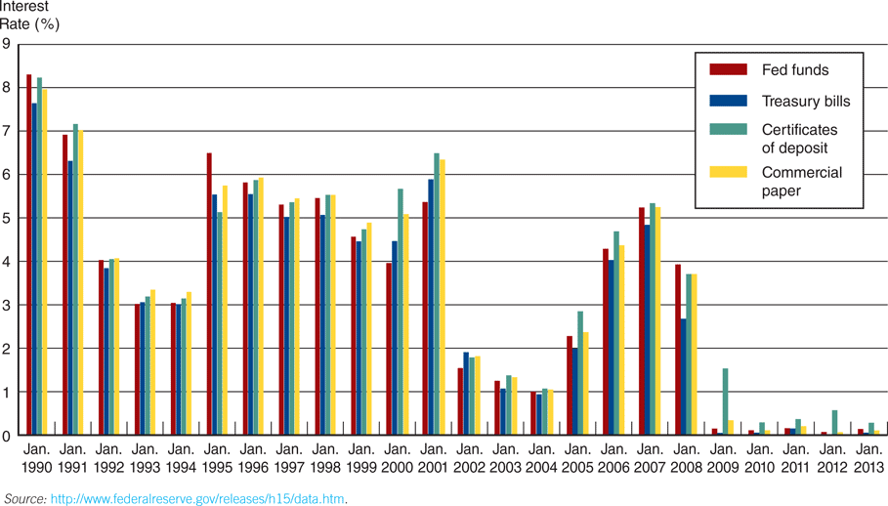
Figure 11.7 Interest Rates on Money Market Securities, 1990–2013

Slide 48
Comparing Money Market Securities
Liquidity is also an important feature, which is closely tied to the depth of the secondary market for the various instruments.
Treasury bills: extensive and well developed
Commercial paper: not well developed

Slide 49
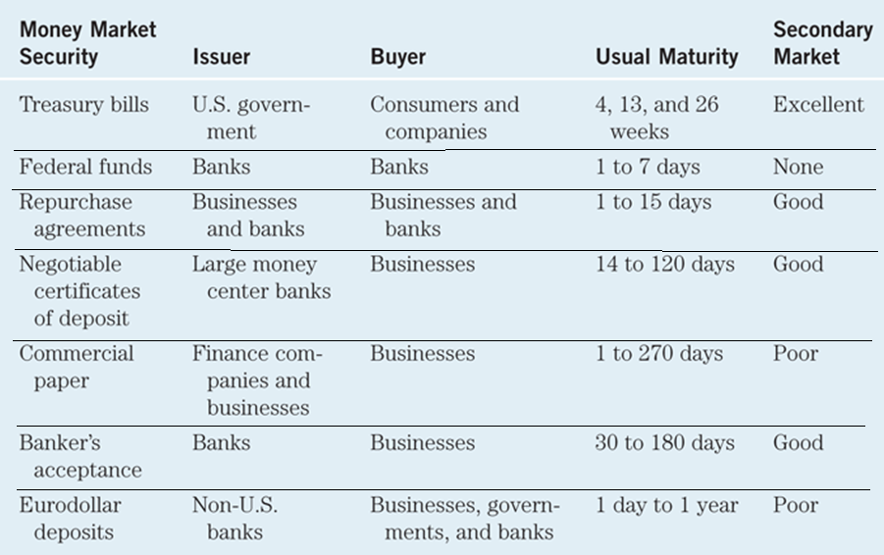
Table 11.4 Money Market Securities and Their Markets

Slide 50
Interaction among Money Market Securities
Interaction among Money market yield.
Instruments have similar yield.
During periods of heightened uncertainty about the economy, investors tend to shift from risky money market securities to Treasury securities. (flight to quality)
Consider the effect of the terrorist attack on September 11, 2001: the economy was weak at the time ➔ investors anticipated that the event would cause additional weakness ➔ sold stocks and transferred funds into money market securities such as T-bill and commercial paper ➔ strong demand for money market securities ➔ push up the price and push down their yields. ➔ all money market security yields declined to their lowest level in more than 30 years.
https://www.cnbc.com/quotes/US3M

Slide 51
Chapter Outline
The Money Markets Defined
The Purpose of Money Markets
Who Participates in Money Markets?
Money Market Instruments
Comparing Money Market Securities

